Slide 1


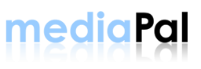
THE OPPORTUNITY
WHO
WE ARE
SERVICES & TARGETS
THE
MARKET

Slide 2
THE OPPORTUNITY
WHO
WE ARE
SERVICES & TARGETS
THE
MARKET
The Fact:
Digital and mobile content distribution is the fastest growing segment of
e-commerce today.
The Need:
An industry-wide utility positioned at the nexus of those who own the content (owners), those who distribute the content (distributors), and the consumers.
The need becomes only greater with the exponential growth of “non traditional” internet distribution channels.
Blogs, social networks (e.g. MySpace) and other high-traffic portals contain massive audiences that have yet to be fully exploited as digital content consumers.
The Answer:
MediaPal.

Slide 3
THE OPPORTUNITY
WHO
WE ARE
SERVICES & TARGETS
THE
MARKET
Established in 2003, we are the developer, owner and operator of the first-to-market digital and mobile content management system (CMS) – the direct-to-consumer solution for entertainment and media.
Best-in-class provider of solutions for:
  Content management
  Online sales
  Product publishing
  Promotion
Proven content management platform, retailer portals, “portable” publishing system, and direct-to-consumer infrastructure
  Manage every aspect of a consumer transaction, fulfillment and customer service
  Provide content owners a turnkey solution to sell and manage digital, mobile and physical products
  Enable content owners to enter consumer markets with zero barriers
OUR MARKET POSITION
Across all points of
entry and access,
we have identified
and commercialized
the nexus of
demand and delivery,
at a single service point.

Slide 4
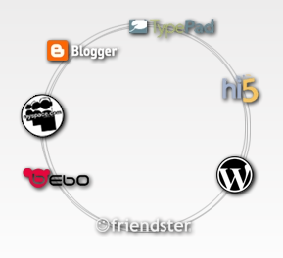
THE OPPORTUNITY
WHO
WE ARE
SERVICES & TARGETS
THE
MARKET
We are a platform that covers virtually any and all sales channels.
Platform to sell digital, mobile and physical products anywhere
“Portable” technology allows users to copy and paste “Sell” button on any internet property, reaching millions of customers.
Using micro-payment processing, sell digital and physical goods directly to customers wherever they are
We are versatile, flexible, credible.
Platform was designed for all scopes and sizes
System is used by thousands of content owners, record labels and media organizations
Working with some of the most notable, prestigious and recognized names in the business, managing millions of media products and transactions

Slide 5
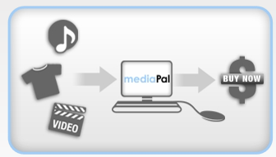

THE OPPORTUNITY
WHO
WE ARE
SERVICES & TARGETS
THE
MARKET
We are a conduit to unparalleled exposure for content creators.
Uploading and posting products to sell is easy and free – placing creators in front of a big audience
  Every music title, video, ringtone
  and product is able to be searched for and re-sold by thousands of registered affiliates
By registering with MediaPal as an affiliate, users are able to sell products through multiple channels, such as:
  Emailing “Buy” buttons
  Embedding them in a blog or MySpace page
  Creating an RSS feed or podcast
  Downloading / sharing them over peer-to-peer networks

Slide 6
THE OPPORTUNITY
WHO
WE ARE
SERVICES & TARGETS
THE
MARKET
Efficiently developing and managing resources across
three major product and service divisions:
CONSUMER
ENTERPRISE
BUSINESS TO BUSINESS
Enterprise Products
& Services
Promotional Products
& Services
Affiliate Sales
& Marketing
Mobile Products
& Services
Direct to Consumer
Sales
Social Network Sales
& Marketing
Mobile
Sales
B2B Products
& Services
Data Mining
& Resale

Slide 7

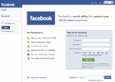
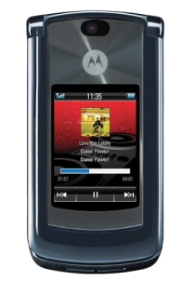
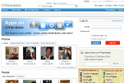






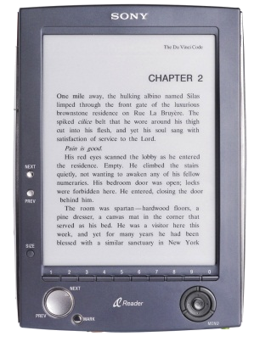

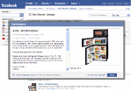


THE OPPORTUNITY
WHO
WE ARE
SERVICES & TARGETS
THE
MARKET
Representative Service Sectors
Video
Music
Mobile
Social Networks
Packages
Websites
PDAs / E-books
Web blogs
Physical Merchandise

Slide 8
THE OPPORTUNITY
WHO
WE ARE
SERVICES & TARGETS
THE
MARKET
ENTERPRISE
MEDIA ORGANIZATIONS
CLOTHING APPAREL
& RETAIL COMPANIES
INDEPENDENT
MEDIA DISTRIBUTION ORGANIZATIONS
TARGET MARKETS
MARKETING
& ADVERTISING AGENCIES
SEARCH ENGINES
HIGH TRAFFIC
& COMMUNITY PORTALS
SOCIAL NETWORKS
& WEB BLOGS

Slide 9
THE OPPORTUNITY
WHO
WE ARE
SERVICES & TARGETS
THE
MARKET
Research validates the market readiness for MediaPal
Consumer digital content sales trending to grow annually by 200% until 2015
Digital and mobile media distribution -- a competitive commercial necessity
Most individuals and media organizations are neither ready nor equipped to competitively participate in this expanding media distribution revolution
MediaPal has the solution
Our portable and “Copy and Paste” distribution technology and portal solutions are the first-to-market solution
Our platform allows individuals and businesses to sell protected
digital, mobile, and physical media without any
resources, start-up costs, or consulting

Slide 10
THE OPPORTUNITY
WHO
WE ARE
SERVICES & TARGETS
THE
MARKET
Our marketing approach
Combine traditional and progressive advertising, PR and sales approaches
Brand MediaPal while exploiting co-branding opportunities
Leverage high-profile organizations that have and will align with us,
pursue and implement integrated publicity and public relations strategies
Three-phase, success-focused marketing strategy
Phase One: securing high profile, enterprise level accounts
“First In” barrier has been broken: We currently provide digital, and physical distribution for Photo Finish Records and VP Records
Phase Two: continue to build distribution relationships with well-known artists/record labels
Other labels and independent content owners contracted to begin additional projects using the MediaPal Platform
Phase Three: Establishing our position as “the” premier brand for digital distribution solutions
The “Company who has been behind the companies”
all along

Slide 11
THE OPPORTUNITY
WHO
WE ARE
SERVICES & TARGETS
THE
MARKET
Competitive Consideration: A simple statement
With MediaPal’s portable, flexible and scalable solutions, our platform provides content owners and distributors with abilities that no other product has been able to offer
MediaPal Competitors
portable buy solutions;
ability to sell media on any Internet property
multi-product sales integration
cost-effective solutions
a selection of tools for customization
and transparency to consumers
robust content management systems
and controls panels
integrated systems such as Inventory,
Fulfillment, and Customer Service modules
☑ 
☑ 
☑ 
☑ 
☑ 
☑ 

